Slide 1
AI ASSISTED CODING
LAB 10

Slide 2
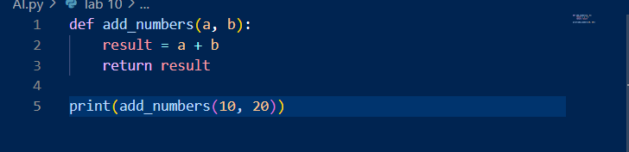
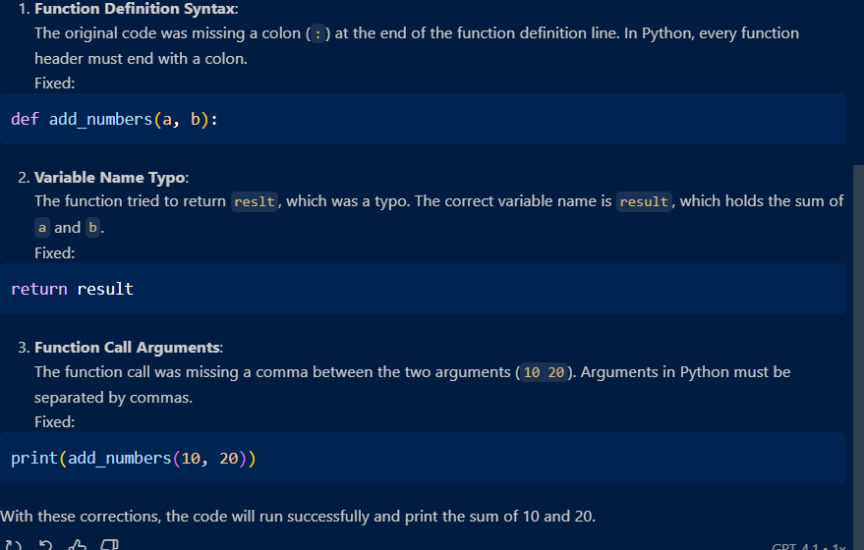
Task 1: Syntax and Error Detection Task: Identify and fix syntax, indentation, and variable errors in the given script

Slide 3
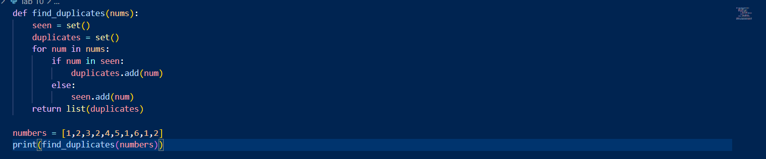
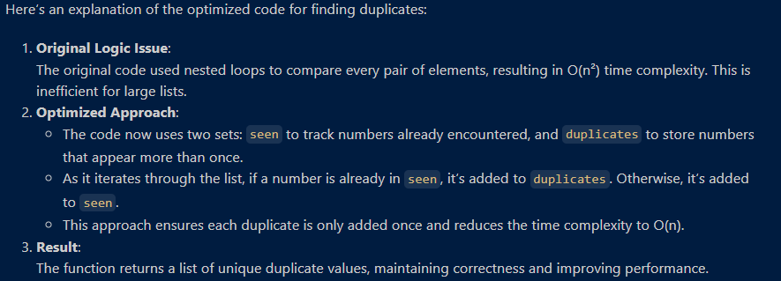
Task 2: Logical and Performance Issue Review
Task: Optimize inefficient logic while keeping the result correct.

Slide 4
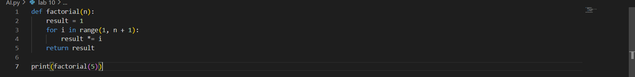
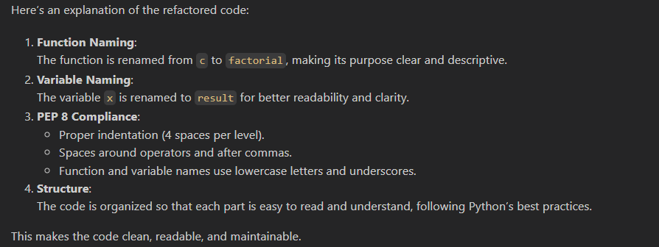
Task 3: Code Refactoring for Readability
Task: Refactor messy code into clean, PEP 8–compliant, well-structured code.

Slide 5
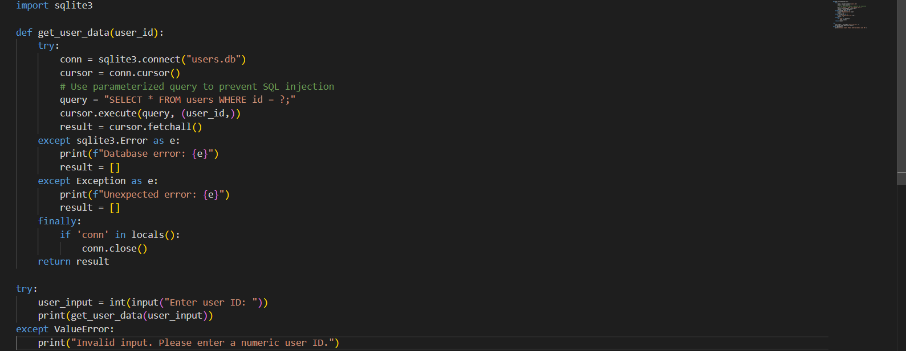
Task 4: Security and Error Handling Enhancement
Task: Add security practices and exception handling to the code

Slide 6
Task 4: Security and Error Handling Enhancement
Task: Add security practices and exception handling to the code.

Slide 7
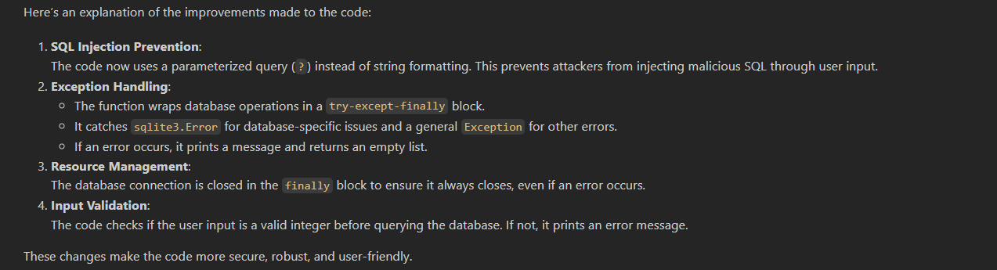
Task 5: Automated Code Review Report Generation
Task: Generate a review report for this messy code.

Slide 8
